Slide 1
IBM FileNet CPE 5.2 New Features
Ting Zheng and Jason Du – IBM FileNet Support Engineer
September 2014

Slide 2
Agenda
1. Shared Data Sources and Database Connection Objects
2. Offline GCD Support
3. CBR Query Optimization
4. RecoveryBin
5. Sweep Framework and Features
6. Storage Area Enhancement

Slide 3
1. Shared Data Sources and Database Connection Objects
Documentation link:
http://www-01.ibm.com/support/knowledgecenter/?lang=en#!/SSNW2F_5.2.0/com.ibm.p8.ce.admin.tasks.doc/p8pcb027.htm
Shared Data Sources:
Configure object stores to use the same data sources
Database Connection Object:
New P8 Domain Configuration Object

Slide 4
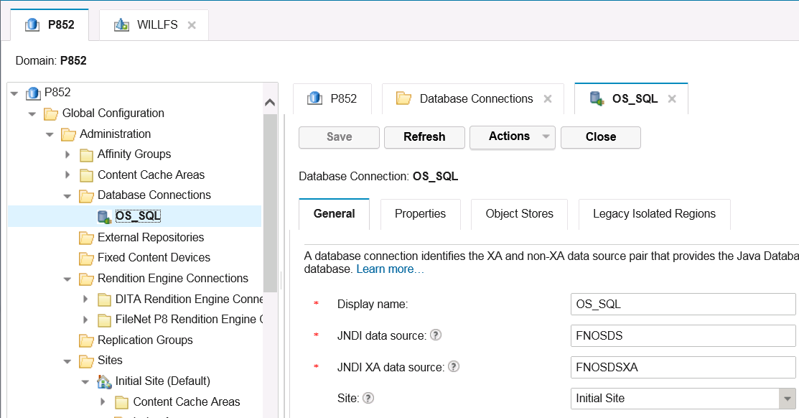
1. Shared Data Sources and Database Connection Objects

Slide 5
1. Shared Data Sources and Database Connection Objects
Shared Data Sources – Benefits
Reduced usage of database connections
A single data source connection pool can service multiple stores
Allowed when object stores reside in the same database
Reduced administrative overhead
The DBA can have fewer databases to create and maintain
The App Server administrator can create fewer data sources

Slide 6
1. Shared Data Sources and Database Connection Objects
Shared Data Sources – Implementation
Object stores sharing a data source will reside in a different schema in the shared database
Requires that a schema name be supplied at object store creation
CPE database access now qualifies object names with a schema name prefix
For Oracle, additional permissions are needed:
http://www-01.ibm.com/support/knowledgecenter/?lang=en#!/SSNW2F_5.2.0/com.ibm.p8.ce.admin.tasks.doc/p8pcc168.htm
GCD database is not allowed to share its data source

Slide 7
1. Shared Data Sources and Database Connection Objects
Database Connection Objects
Consists of JDBC Data Sources (XA and non-XA) and Site for locality
Replaces Object Store JDBC Data Source and Site properties
OS Site and DS pair now pulled from Database Connection
Enables connection object sharing
Multiple object stores can reference same connection object
Must use different schema names
Objects with a DatabaseConnection property will always have a matching DatabaseSchemaName property to facilitate sharing

Slide 8
1. Shared Data Sources and Database Connection Objects
Content Engine Upgrade to 5.2.0
A new DatabaseConnection object is created for each object store
CE auto-upgrade mechanism does this automatically
Data source and Site properties are populated
DatabaseSchemaName object store property is also populated
The value is set to the default schema name for that connection
Pre-5.2.0 systems had to use the default schema name

Slide 9
2. Offline GCD Support
Background
GCD (Global Configuration Database)
CE servers in geographically distributed environments quickly failed if this central database became unavailable.
CE 4.5.1: "read-only GCD mode"

Slide 10
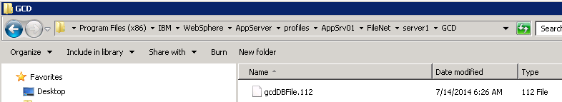
2. Offline GCD Support
In 5.2.0, CPE introduces Offline GCD Support
GCDMonitor task (on each server instance) writes out GCD data into file system
Location of the file is in sub-folder named 'GCD' in the same folder as p8 logs
Upon server startup and beyond, if the GCD database is unavailable, the server will look for this file and read its content into memory
The server's switch to the file-based copy is referred to as File Fallback Mode

Slide 11
3. CBR Query Optimization
Documentation link:
http://www-01.ibm.com/support/knowledgecenter/?lang=en#!/SSNW2F_5.2.0/com.ibm.p8.ce.dev.ce.doc/query_sql_syntax_cbr.htm?cp=SSNW2F_5.2.0%2F10-2-1-33-4-2
How CBR search works?
SELECT d.This, d.ClassDescription
FROM Document d INNER JOIN ContentSearch cs ON d.This = cs.QueriedObject WHERE CONTAINS(d.*, 'IBM') and d.date1 >= 2014-01-01T00:00:00

Slide 12
3. CBR Query Optimization
Background:
Slow CBR searches in this circumstance
There were many full text search hits
There were few relational database hits
Example:
Millions of content indexed documents
•Each document's content includes word 'IBM'
Only one document added in year 2014

Slide 13
3. CBR Query Optimization
Current Limitation
Can only perform the full text portion of the search first
Works well if there are not a large number of full text hits
Work poorly if there are many full text hits and many iterations of the join query are needed to fill a client page request

Slide 14
3. CBR Query Optimization
New Design:
Object Stores can be configured to “Dynamically Switch”
If the estimate > threshold, DB First
Otherwise, Content First
Benefits:
Allows much faster searches when there are not a lot of relational DB hits

Slide 15
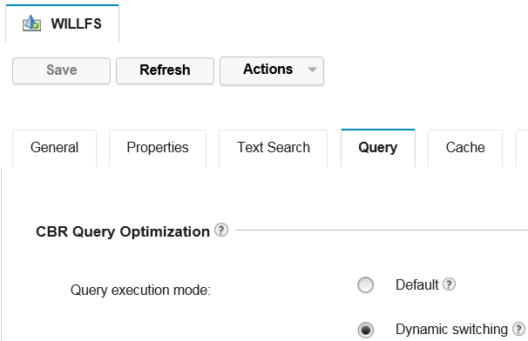
3. CBR Query Optimization
Object Store Enablement
Set the CBR Query Optimization property on each Object Store
- Default value is Null (not set)
Searches are done Content First
- Set to value of 1
Searches will Dynamically Switch
Set CBR Query Dynamic Threshold property
- For example: 10000
- Only used if CBR Query Optimization property
is set to 1
See documentation for limitations and unsupported searches

Slide 16
3. CBR Query Optimization
Best Practices
To ensure that DB first searches execute efficiently, set database criteria on indexed properties.
Specify limiting conditions on database criteria to achieve relatively small hit counts.
DB first searches are most effective when the database hit count is relatively small.
If the CBR hits are spread across many collections, this requires an increasingly larger threshold
See P8 documentation for a table of minimum threshold

Slide 17
4. RecoveryBin
Documentation link:
http://www-01.ibm.com/support/knowledgecenter/?lang=en#!/SSNW2F_5.2.0/com.ibm.p8.ce.dev.ce.doc/recoverybin_procedures.htm?cp=SSNW2F_5.2.0%2F10-2-1-32-6
This feature enables an object in the Content Engine to be marked for deletion and put into RecoveryBin, it can then either be completely purged from the system, or be recovered back into its original state

Slide 18
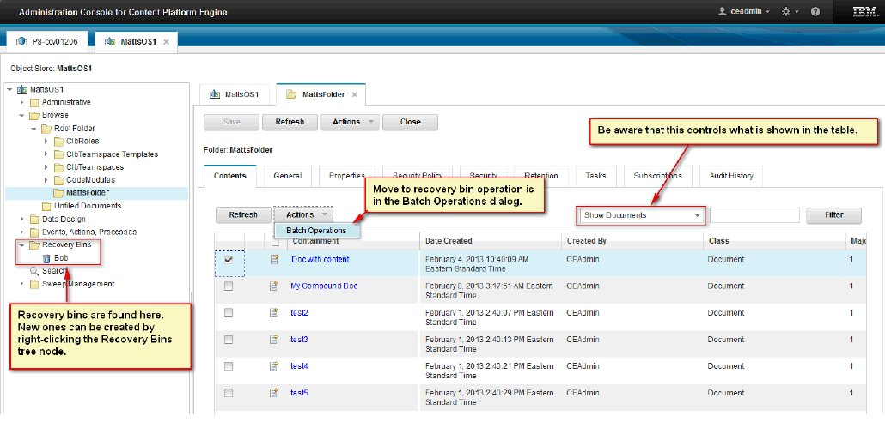
4. RecoveryBin

Slide 19
4. RecoveryBin
Scope:
Recovery bin can be created and accessed in ACCE, but not in AE, WPXT or Navigator
Supported only on the VersionSeries and CustomObject as the top level objects.
The following object types may not be soft deleted:
Folder
CompoundDocument
FederatedDocument

Slide 20
5. Sweep Framework and Features
Sweep Framework and new features that use it to:
Automatic disposal
Automatic and bulk retention update
Bulk move content

Slide 21
5. Sweep Framework and Features
Sweep Framework
Types of Sweeps
Jobs Sweeps
Bulk Move Content Demo
Policy Controlled Sweeps
Sweep Policies
Disposal Policy Demo
Course Summary

Slide 22
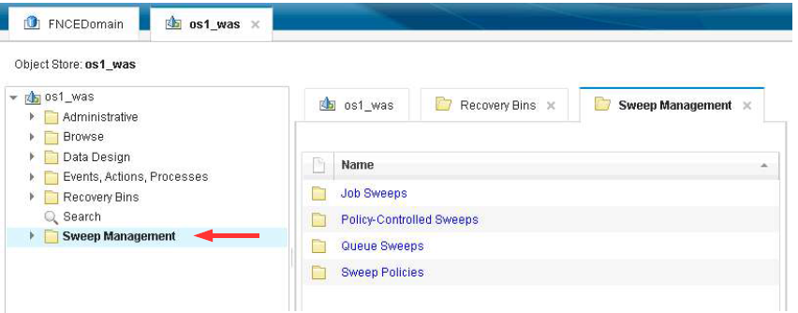
5. Sweep Framework and Features

Slide 23
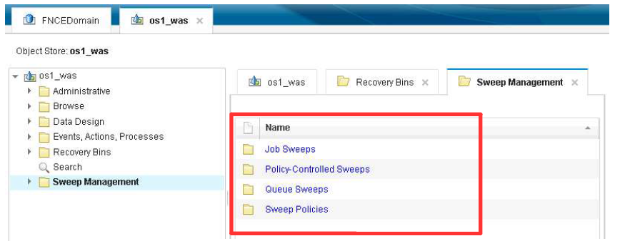
5. Sweep Framework and Features

Slide 24
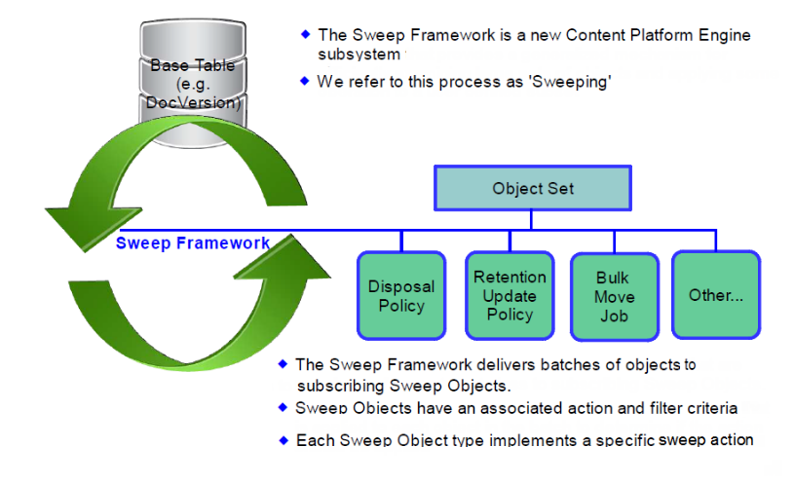
5. Sweep Framework and Features

Slide 25
5. Sweep Framework and Features
Services offered by the Sweep Framework:
Scalability
Horizontal scaling
Vertical scaling
Load management
Varying the allocation of server resources to sweeping
Scheduling
Sweeps can be scheduled to run
Allows resource intensive sweep operations to occur during off-peak hours
The ability to halt and resume execution
Failure recovery
Error logging and auditing
Performance monitoring

Slide 26
5. Sweep Framework and Features
Sweep Framework
Types of Sweeps
Jobs Sweeps
Bulk Move Content Demo
Policy Controlled Sweeps
Sweep Policies
Disposal Policy Demo
Course Summary

Slide 27
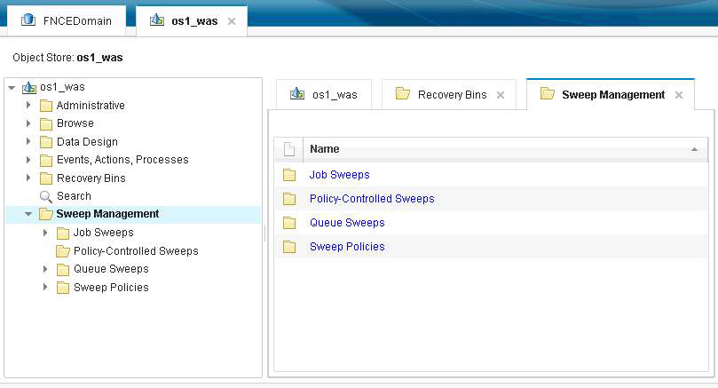
5. Sweep Framework and Features

Slide 28
5. Sweep Framework and Features
There are two fundamental types of sweeps:
once-only and ongoing.
But because there are two subtypes of ongoing sweeps, there are three named sweep types:
Jobs Sweeps: Once-only
Policy Controlled Sweeps: Ongoing
Queue Sweeps Ongoing

Slide 29
5. Sweep Framework and Features
Sweep Framework
Types of Sweeps
Jobs Sweeps
Bulk Move Content Demo
Policy Controlled Sweeps
Sweep Policies
Disposal Policy Demo
Course Summary

Slide 30
5. Sweep Framework and Features
Jobs Sweep
Performs single iteration sweep
Has a definite start and completion
Starts when the first candidate object is visited
Ends when each candidate object have been visited exactly one time (or if terminated early)
Once complete, a Sweep Job cannot be restarted
Jobs Sweeps are useful for performing one-time-only bulk updates of many objects
Examples:
Bulk Move Content Job
Bulk Retention Update Job
Thumbnail Generation Job

Slide 31
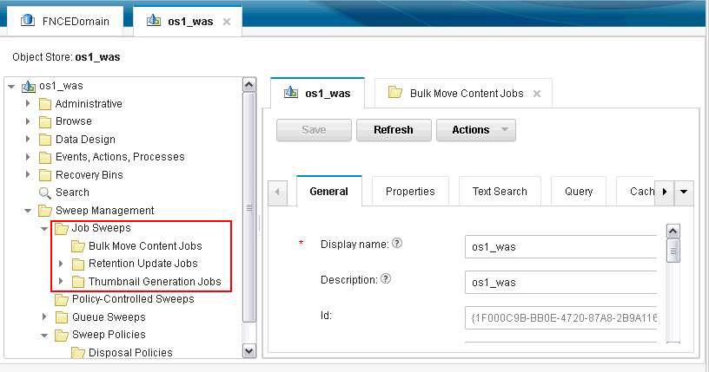
5. Sweep Framework and Features
Type of Jobs Sweep:

Slide 32
5. Sweep Framework and Features
Bulk Move Content Job:
Used for moving content from one storage area to another for Documents or Annotations
The set of affected documents (or annotations) is determined by the Target Class, Include Subclasses, and Filter Expression Properties.
Target Class must point to a Document or Annotation class or a subclass of either
Destination for moved content determined by the Storage Policy
If the content for an object that is a member of the Sweep Target class is already stored in one of the Storage Areas referenced by the Storage Policy, the content is not moved and the Process Object Count property is not incremented

Slide 33
5. Sweep Framework and Features
Bulk Move Content Job:
Example Use Cases:
Archiving content by moving it from primary storage device to archival device or lower cost storage
Retiring an obsolete storage device by moving all the content to a replacement device
Moving federated content from the source repository into a native P8 storage device
Moving content into fixed storage for regulatory purposes

Slide 34
5. Sweep Framework and Features
Sweep Framework
Types of Sweeps
Jobs Sweeps
Bulk Move Content Demo
Policy Controlled Sweeps
Sweep Policies
Disposal Policy Demo
Course Summary

Slide 35
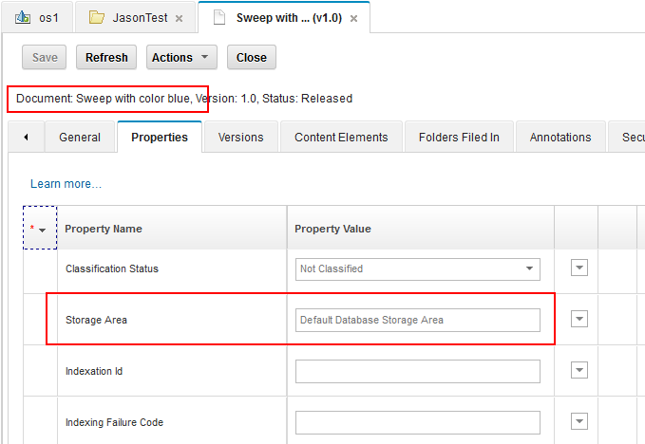
5. Sweep Framework and Features
Bulk Move Content Demo:

Slide 36
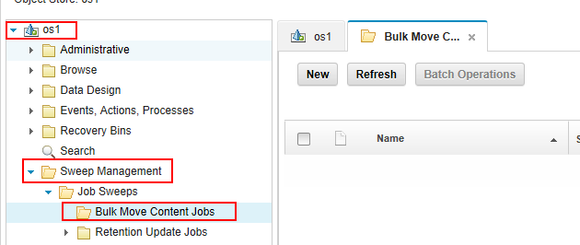
5. Sweep Framework and Features
Bulk Move Content Demo:

Slide 37
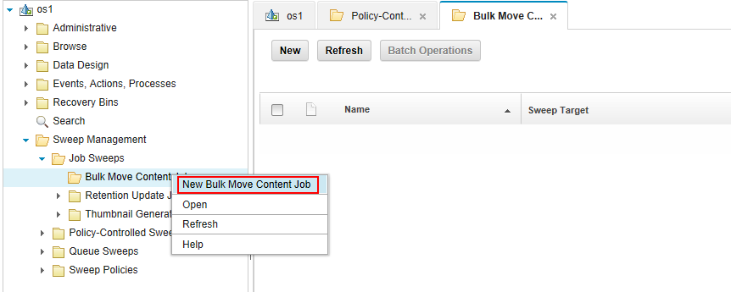
5. Sweep Framework and Features
Bulk Move Content Demo:

Slide 38
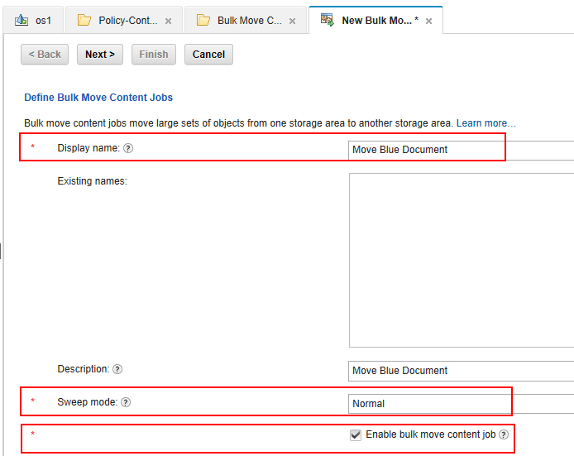
5. Sweep Framework and Features
Bulk Move Content Demo:

Slide 39
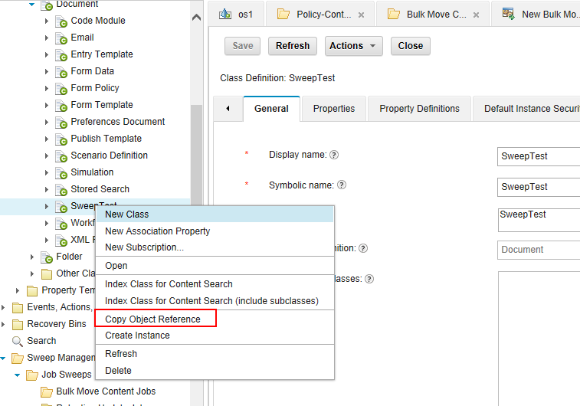
5. Sweep Framework and Features
Bulk Move Content Demo:

Slide 40
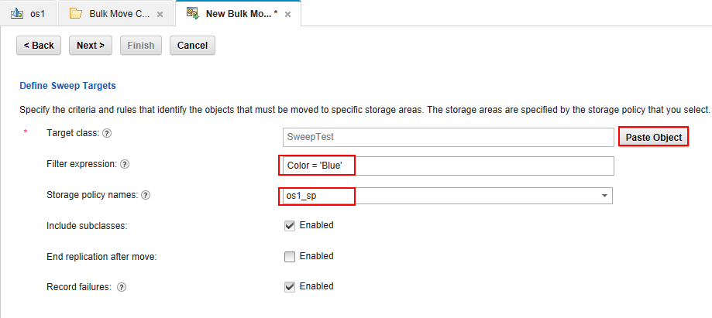
5. Sweep Framework and Features
Bulk Move Content Demo:

Slide 41
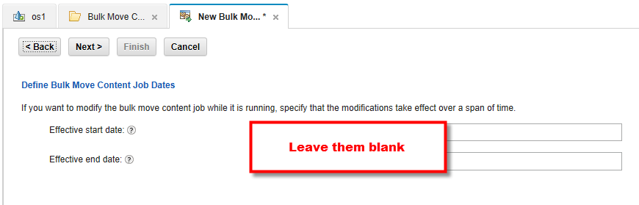
5. Sweep Framework and Features
Bulk Move Content Demo:

Slide 42
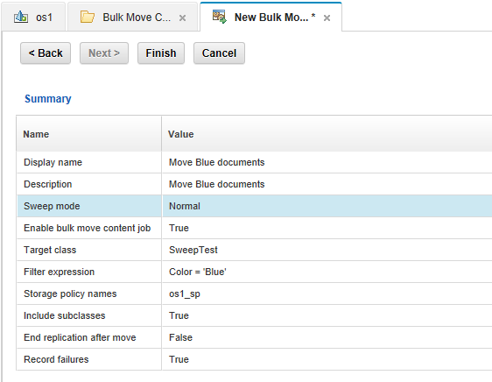
5. Sweep Framework and Features
Bulk Move Content Demo:

Slide 43
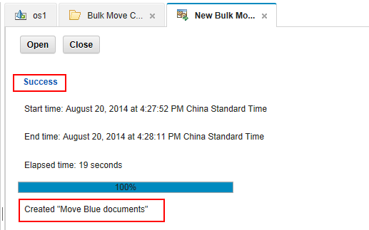
5. Sweep Framework and Features
Bulk Move Content Demo:

Slide 44
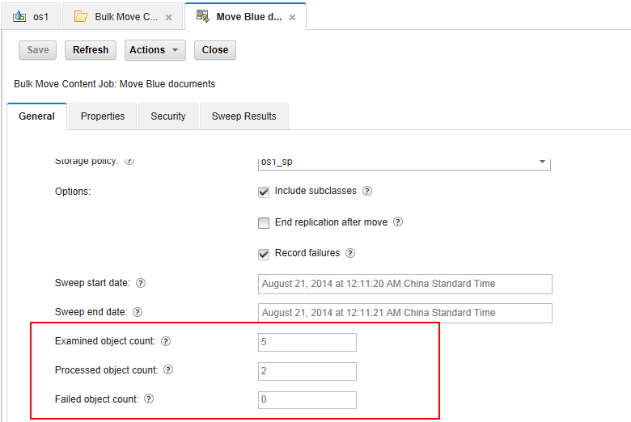
5. Sweep Framework and Features
Bulk Move Content Demo:

Slide 45
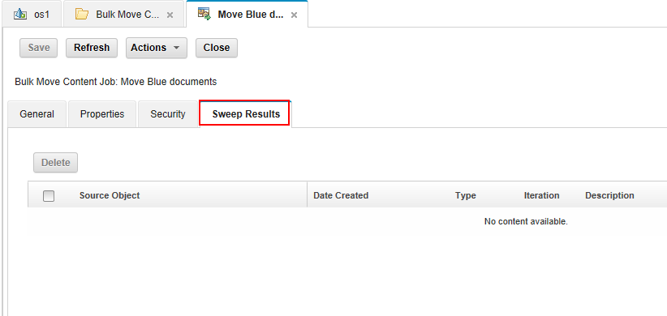
5. Sweep Framework and Features
Bulk Move Content Demo:

Slide 46
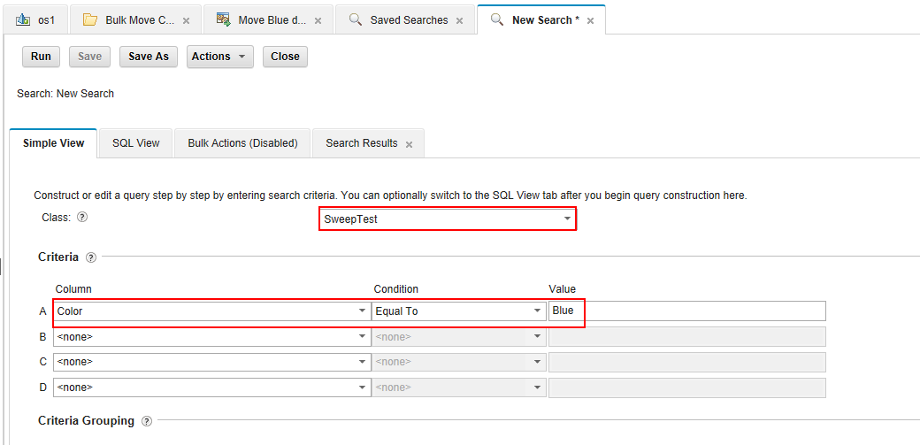
5. Sweep Framework and Features
Bulk Move Content Demo:

Slide 47
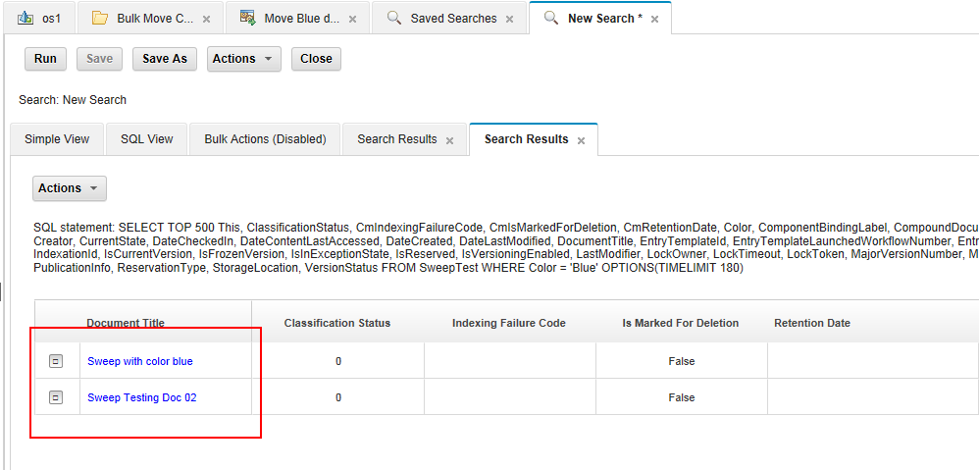
5. Sweep Framework and Features
Bulk Move Content Demo:

Slide 48
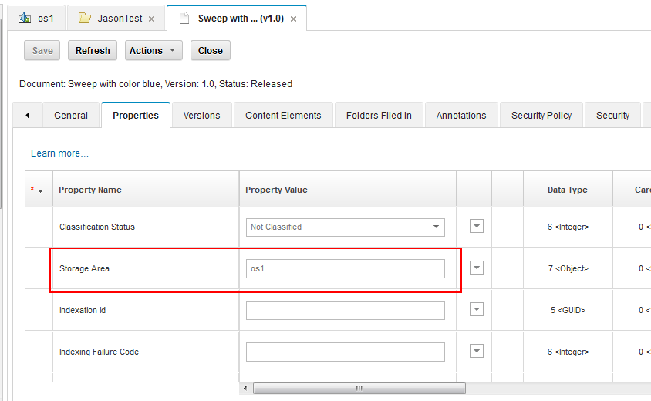
5. Sweep Framework and Features
Bulk Move Content Demo:

Slide 49
5. Sweep Framework and Features
Sweep Framework
Types of Sweeps
Jobs Sweeps
Bulk Move Content Demo
Policy Controlled Sweeps
Sweep Policies
Disposal Policy Demo
Course Summary

Slide 50
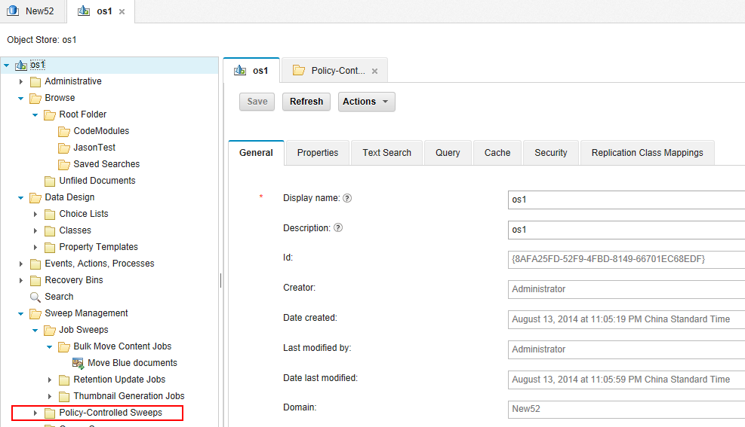
5. Sweep Framework and Features
Policy Controlled Sweeps:

Slide 51
5. Sweep Framework and Features
Policy Controlled Sweeps
Performs multiple sweep iterations
Definite Start, Indefinite completion
Policy Controlled Sweeps continue to execute until they are either disabled or deleted
A Policy Controlled Sweep is related to Sweep Policies
Useful for performing operations that need to be triggered by calendar based events
E.g. automatically dispose objects when their retention date has expired
This cannot be done using event actions because there no object update to trigger the event
Can not be created directly. Instead indirectly created by creating a Sweep Policy

Slide 52
5. Sweep Framework and Features
Important properties of Policy Controlled Sweeps
Sweep Target
A root class, e.g. Document
Does not have a Filter Expression property
Completed Iterations
Counters:
Examined Object Count
Processed Object Count
Failed Object Count
Current Examined Object Count
Current Processed Object Count
Current Failed Object Count
Timeslots
Sweep Subscribers

Slide 53
5. Sweep Framework and Features
Sweep Framework
Types of Sweeps
Jobs Sweeps
Bulk Move Content Demo
Policy Controlled Sweeps
Sweep Policies
Disposal Policy Demo
Course Summary

Slide 54
5. Sweep Framework and Features
Sweep Policy
Subscribes to a Policy Controlled Sweep
Sweep Target and Filter Expression property
Counter properties (current and cumulative)
Effective Start and End Date properties
Sweep Results
Does not have Timeslots property

Slide 55
5. Sweep Framework and Features
Disposal Policy
Allows Object Store administrators to define conditions for when objects of a specified type will be automatically deleted
Target Class must be defined as 'Searchable'
Holds and Retention
Candidate objects to which a native Hold is currently applied or that have a Retention Date value that is in the future are silently ignored
Delete operations are carried out with the access rights

Slide 56
5. Sweep Framework and Features
Retention Update Policy
Just like a Retention Update Job with two exceptions:
It is policy based, so it executes indefinitely
Does not support retention reduction
Useful for setting retention based on the age of the object when update events cannot be used.

Slide 57
5. Sweep Framework and Features
Sweep Framework
Types of Sweeps
Jobs Sweeps
Bulk Move Content Demo
Policy Controlled Sweeps
Sweep Policies
Disposal Policy Demo
Course Summary

Slide 58
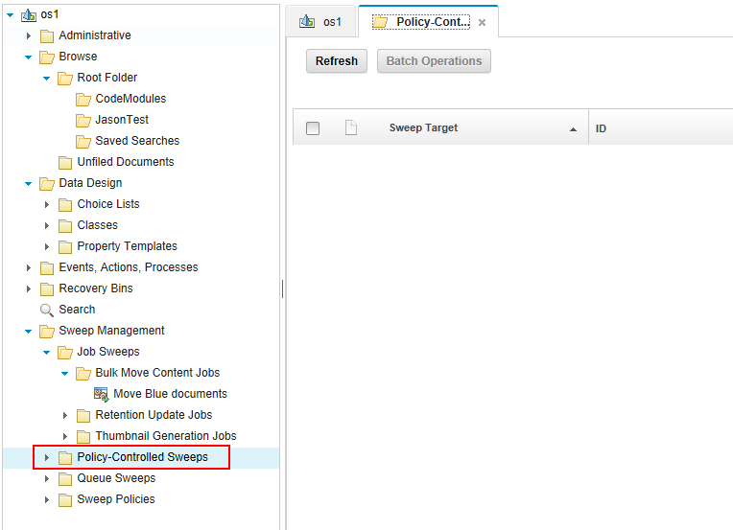
5. Sweep Framework and Features
Disposal Policy Demo

Slide 59
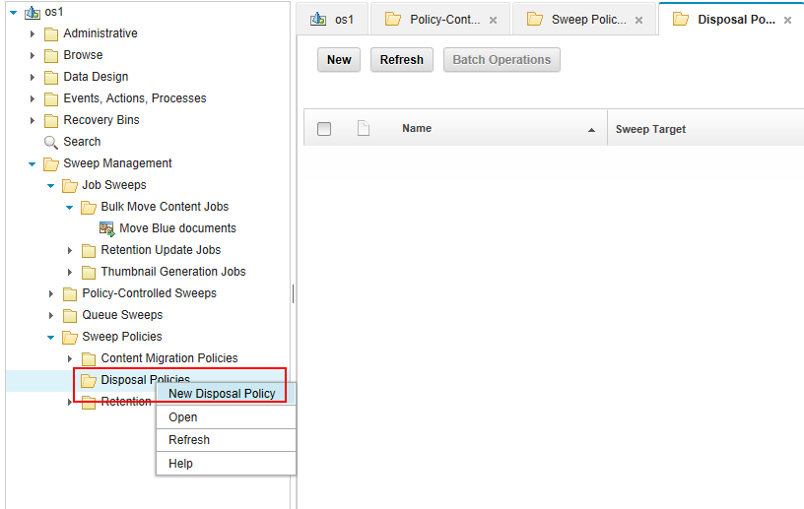
5. Sweep Framework and Features
Disposal Policy Demo

Slide 60
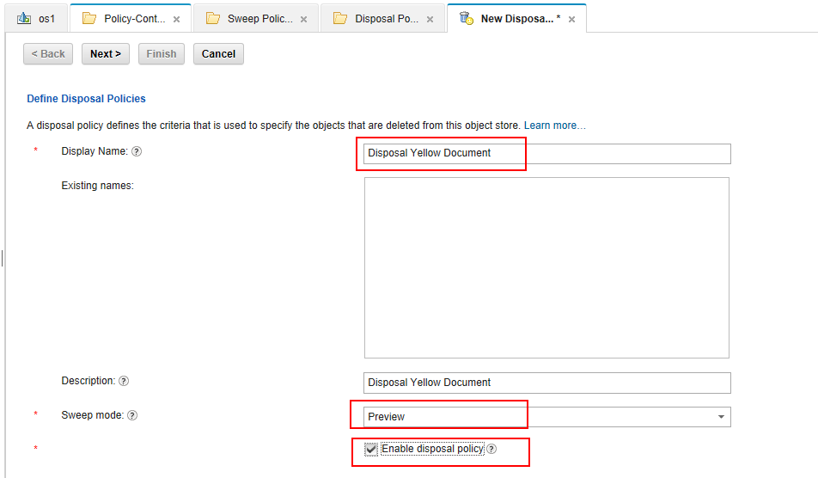
5. Sweep Framework and Features
Disposal Policy Demo

Slide 61
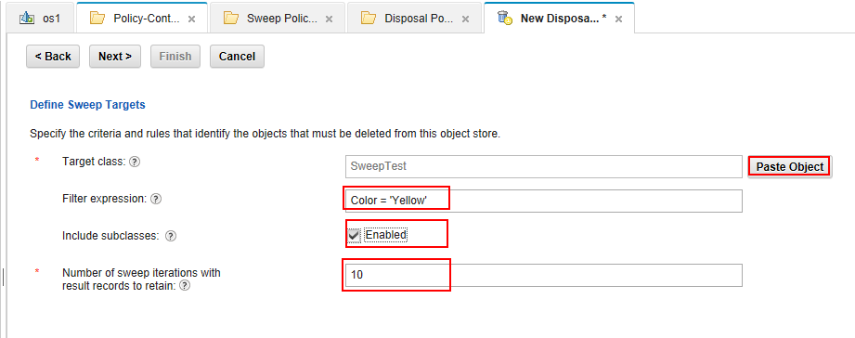
5. Sweep Framework and Features
Disposal Policy Demo

Slide 62
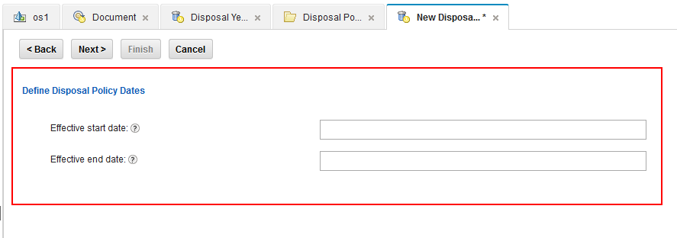
5. Sweep Framework and Features
Disposal Policy Demo

Slide 63
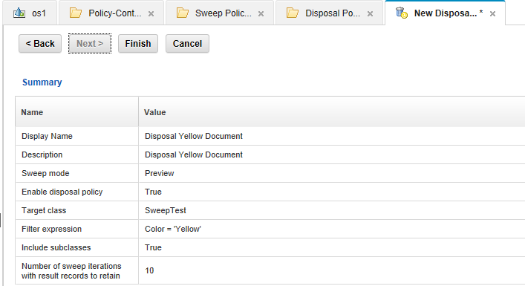
5. Sweep Framework and Features
Disposal Policy Demo

Slide 64
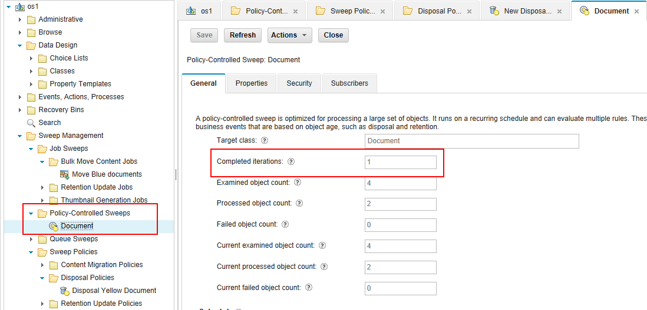
5. Sweep Framework and Features
Disposal Policy Demo

Slide 65
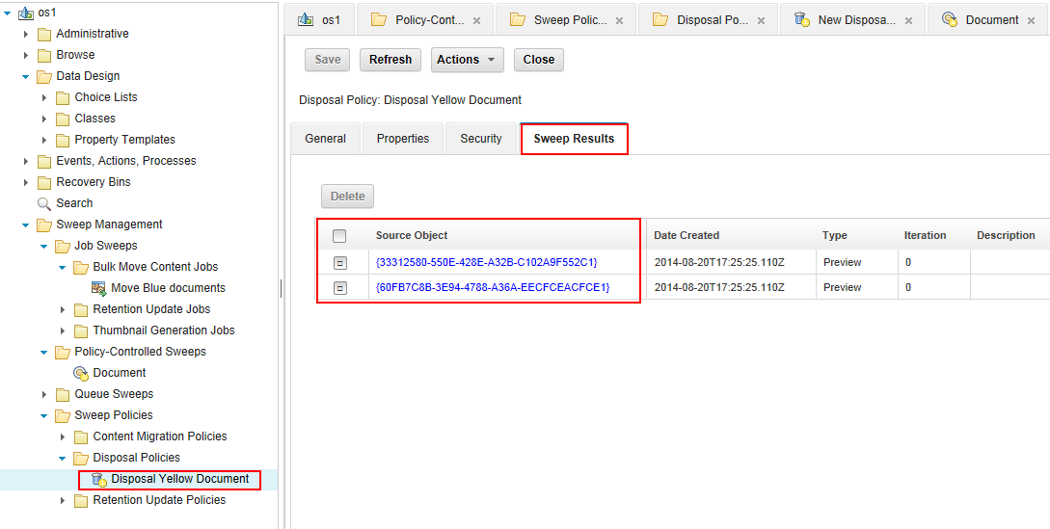
5. Sweep Framework and Features
Disposal Policy Demo

Slide 66
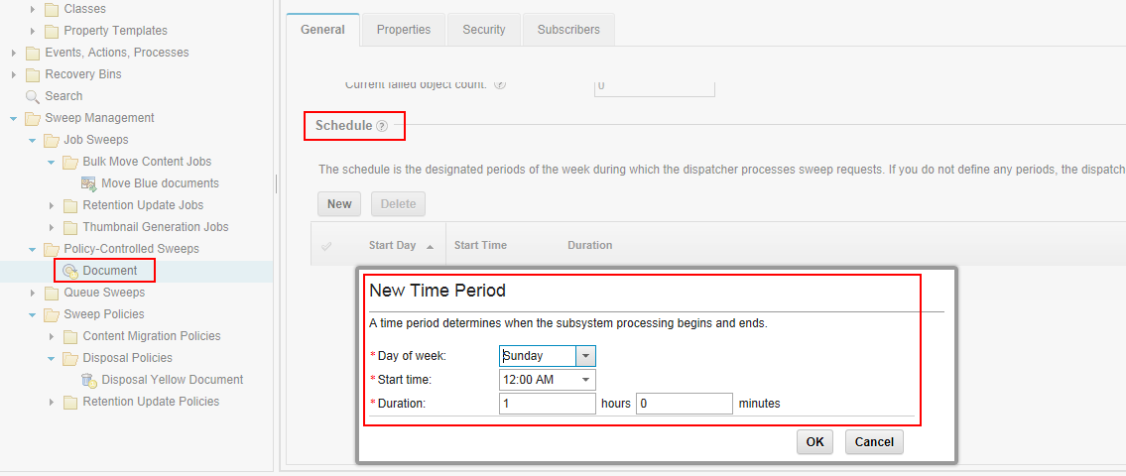
5. Sweep Framework and Features
Disposal Policy Demo

Slide 67
5. Sweep Framework and Features
Sweep Framework
Types of Sweeps
Jobs Sweeps
Bulk Move Content Demo
Policy Controlled Sweeps
Sweep Policies
Disposal Policy Demo
Course Summary

Slide 68
5. Sweep Framework and Features
Course Summary
Describe what the Sweep Framework is
Explain what a Sweep is and describe two basic types
Identify three new features based on the Sweep Framework
Use new Administration Console for Content Engine Platform to create a Bulk Move Content Job and Disposal Policy

Slide 69
5. Sweep Framework and Features
Product Help/Documentation/Resources:
IBM FileNet P8 V5.2 Information Center Topics
V5.2 Information Center Link: http://pic.dhe.ibm.com/infocenter/p8docs/v5r2m0/index.jsp
Administering FileNet P8
  ➔Administering Content Platform Engine
    ➔Managing Objects
        ➔Creating a Bulk Content Move Job
        ➔Creating a Thumbnail Generation Job
        ➔Creating a Disposal Policy
        ➔Retaining Objects

Slide 70
6. Content storage enhancements
Storage Area Activation
Server affinity default setting change for content upload and download
Course Summary

Slide 71
6. Content storage enhancements
Storage Area Activation
Server affinity default setting change for content upload and download
Course Summary

Slide 72
6. Content storage enhancements
Storage Area Activation:
Automatically transition a STANDBY storage area to OPEN when an existing storage area becomes FULL.
Implemented by using Storage Policies with references to multiple storage areas
Storage policy is defined at either the Class level for documents and annotations or the instance level.

Slide 73
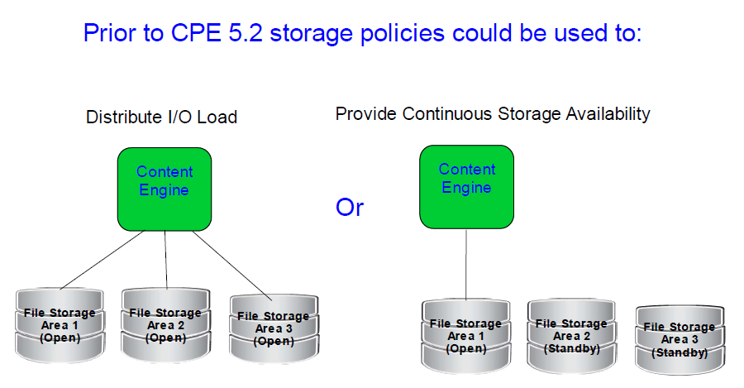
6. Content storage enhancements
Storage Area Activation – Previous behavior:

Slide 74
6. Content storage enhancements
Storage Area Activation – Deficiencies of previous behavior:
STANDBY storage area is opened only if the LAST storage area of a policy becomes FULL.
Customers using storage policies to distribute the I/O load across multiple storage areas cannot automatically maintain the same number of areas as they become full.
STANDY storage areas are not opened in a predictable order.

Slide 75
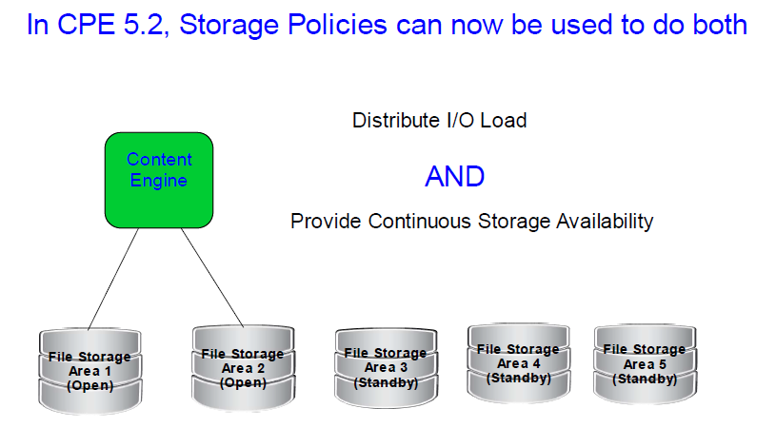
6. Content storage enhancements
Storage Area Activation – New behavior:

Slide 76
6. Content storage enhancements
Storage Area Activation – New Capabilities in CPE 5.2:
Same number of OPEN storage areas can be maintained
When a storage area is transitioning to FULL, a standby area (if one is available) will be immediately activated to maintain the same number of open areas.
STANDBY storage areas can be given a priority indicating the order that they will be opened.
Property CmStandbyActivationPriority
Type Integer.
The value zero (default) is the highest priority.
Ascending values indicate lower priority.

Slide 77
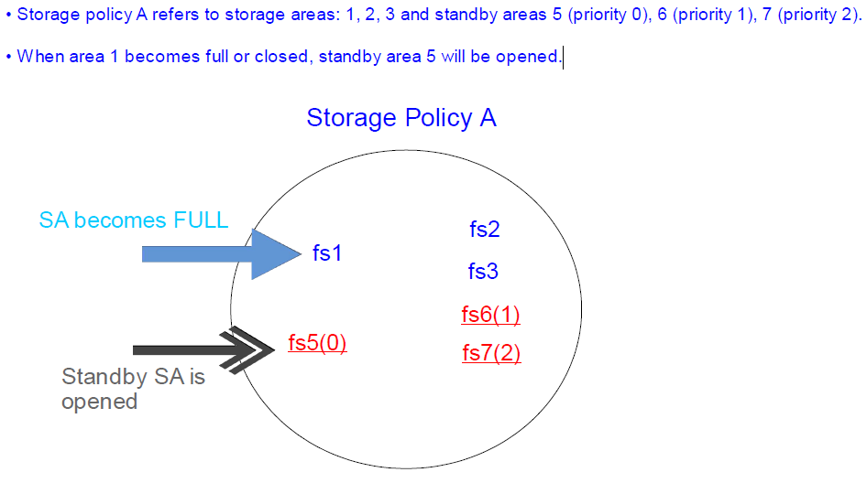
6. Content storage enhancements
Storage Area Activation - Demo 1:

Slide 78
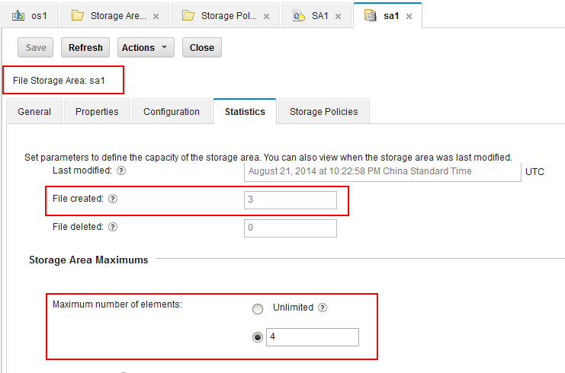
6. Content storage enhancements
Storage Area Activation - Demo 1:

Slide 79
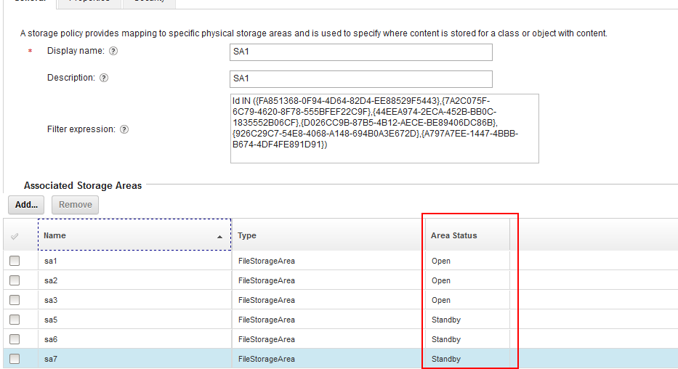
6. Content storage enhancements
Storage Area Activation - Demo 1:

Slide 80
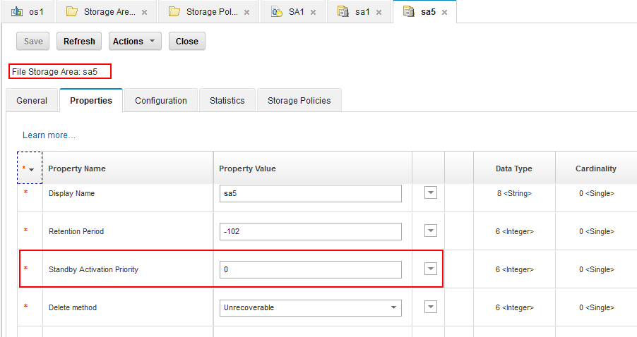
6. Content storage enhancements
Storage Area Activation - Demo 1:

Slide 81
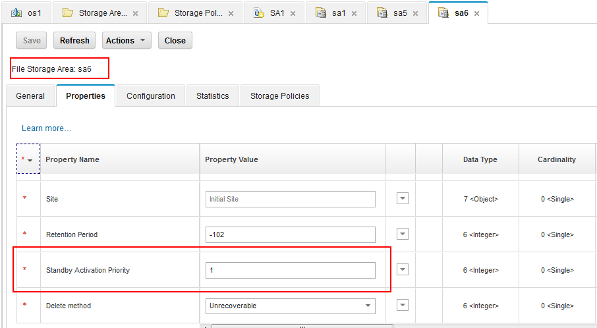
6. Content storage enhancements
Storage Area Activation - Demo 1:

Slide 82
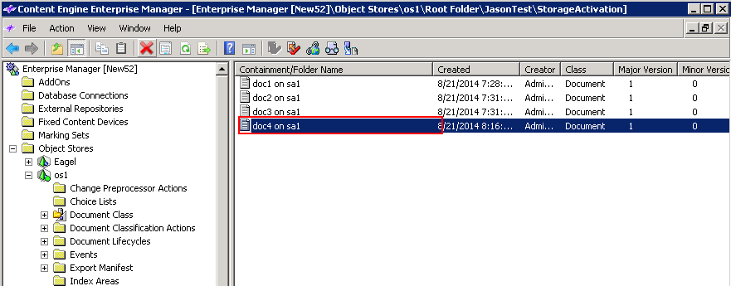
6. Content storage enhancements
Storage Area Activation - Demo 1:

Slide 83
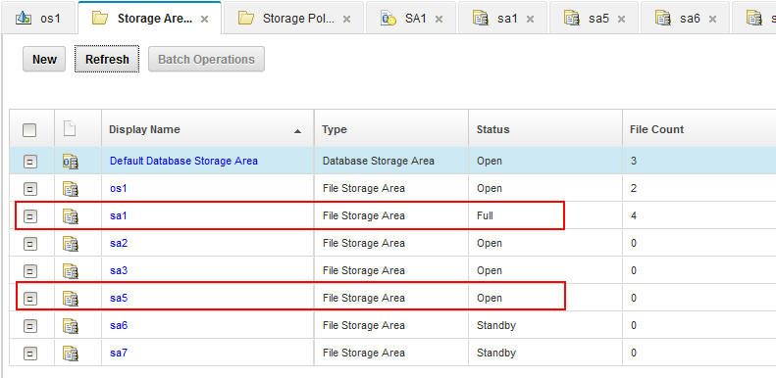
6. Content storage enhancements
Storage Area Activation - Demo 1:

Slide 84
6. Content storage enhancements
Storage Area Activation
Server affinity default setting change for content upload and download
Course Summary

Slide 85
6. Content storage enhancements
Server affinity for content upload and download:
Server affinity for large content uploads and downloads was added as an optional performance tuning enhancement in Content Engine 5.1 when using the EJB transport.
Server affinity causes all requests requiring multiple CE server round-trips to upload or retrieve large content to be handled by the same CE server. This CE server is the one that starts servicing that request.
Content Engine 5.1 required the following JVM settings on the CE client application to enable server affinity
FileNet.Content.UploadServerAffinityEnabled=true
FileNet.Content.DownloadServerAffinityEnabled=true
Content Platform Engine 5.2 now enables server affinity by default so these settings are no longer necessary on the CPE client.

Slide 86
6. Content storage enhancements
Storage Area Activation
Server affinity default setting change for content upload and download
Course Summary

Slide 87
6. Content storage enhancements
Course summary:
Describe and understand storage activation
Describe the server affinity default setting change for content upload and download

Slide 88
6. Content storage enhancements
Product Help/Documentation/Resources:
Content Download HTTP Cache (CDHC) Resources
P8 5.2 Information Center: Administering IBM FileNet Collaboration Services > Configuring cache assistance for large file downloadsThumbnail Concepts
http://pic.dhe.ibm.com/infocenter/p8docs/v5r2m0/topic/com.ibm.installingp8qkr.doc/qkrpi011.htm
Content Compression Resources
P8 5.2 Information Center: Administering Content Platform Engine > Defining the repository infrastructure > Storing content > Controlling the way that content is stored > Content compression
http://pic.dhe.ibm.com/infocenter/p8docs/v5r2m0/topic/com.ibm.p8.ce.admin.tasks.doc/p8pcc125.htm
Storage Area Activation Resources
P8 5.2 Information Center: Administering Content Platform Engine > Defining the repository infrastructure > Storing content > Storage areas > Changing the storage area resource status
http://pic.dhe.ibm.com/infocenter/p8docs/v5r2m0/topic/com.ibm.p8.ce.admin.tasks.doc/contentstores/cs_auto_resource_status.htm

Slide 89
Survey
Please help us to complete the survey of this presentation!
Thank you !

